Slide 1

Lecture 5
Software Design and Architecture
Rana Taimur Khan
Lecturer GCUF

Slide 2
Object Orientation Basic Concepts Object
The object:
Object is a tangible entity that exhibits some well-defined behaviors.
An object represents an individual, identifiable item, unit or entity, either real or abstract, with a well-defined role in the problem domain.

Slide 3
Object Orientation Basic Concepts Object
Three things which an object is contains:
State
Behavior
Identity

Slide 4
Object Orientation Basic Concepts Object
The state:
The state of an object is encapsulated within the object.
It is the current values of the properties of the object.

Slide 5
Object Orientation Basic Concepts Object
The behavior:
How an object acts and reacts in terms of its state changes and message passing.
This is the part of the system intelligence delegated to the object.

Slide 6
Object Orientation Basic Concepts Object
The identity:
Identity is that property of an object which distinguishes it from all other objects.

Slide 7

Object Orientation Basic Concepts Object

Slide 8
Object Orientation Basic Concepts Object
The identity:
Who will provide a specific services?

Slide 9
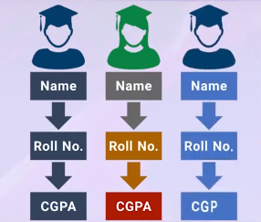
Object Orientation Basic Concepts Class
The class:
The class represents
Similar objects….

Slide 10
Object Orientation Basic Concepts Class
The class
Template of an object that includes properties and behavior.

Slide 11
Object Orientation Basic Concepts Class
The class
The class represents an abstraction..
The abstraction consists of:
Interface
Implementation

Slide 12
Object Orientation Basic Concepts Class
The interface:
Declaration of all the operations applicable to instances of the class.
Outside view / Public Part
What can I do for you.

Slide 13
Object Orientation Basic Concepts Class
The Implementation:
Internally how the abstraction is made that is the implementation.
How the function will perform inside it.
How to use data structure?
How is the algorithms are working?
Inside view/Private Part
How is it actually done?

Slide 14
Relationship between Classes and Objects Association
Objects and Classes:
Two building blocks of the systems
Behavior of the system is defined by the manner in which the objects interact with one another.
In order to construct a software system, we need a mechanisms that create connections between these building blocks.

Slide 15
Relationship between Classes and Objects Association
Relationship between classes:
Association
Inheritance

Slide 16
Relationship between Classes and Objects Association
Association:
Indicate that the objects of the two classes are related in some non-hierarchical way.
Implies that an object of one class is making use of an object of another (or same) class.
Indicate simply by a solid line connected the two class icons.

Slide 17
Relationship between Classes and Objects Association
Association:
Does not imply that there is always a link between all objects of one class and all objects of the other class.
Does implies that there is a persistent, identifiable connection between two classes.

Slide 18
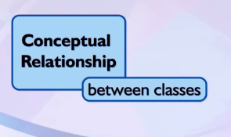
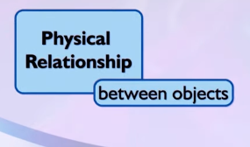
Relationship between Classes and Objects Association

Slide 19
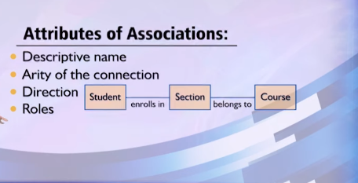
Relationship between Classes and Objects Association

Slide 20

Relationship between Classes and Objects Aggregation and Composition
Aggregation:
A form of association that specifies a whole-part relationship between an aggregate (a whole) and a constituent part.
It is indicated by “hollow” diamond.

Slide 21
Relationship between Classes and Objects Aggregation and Composition
Most experts have downplayed the importance of general form of aggregation as not something that deserves to be embellished in any way.
Think of it as modeling placebo!

Slide 22

Relationship between Classes and Objects Aggregation and Composition
Composite Aggregation:
Also knows as Composition.
Implies that each instance of the part belongs to only one instance of the whole, and that the part cannot exists except as part of the whole.
Composition is indicated with a filled in diamond.

Slide 23
Relationship between Classes and Objects Inheritance
Classification and hierarchy:
Classification of objects into groups of related abstractions.

Slide 24
Relationship between Classes and Objects Inheritance
Inheritance:
Represents a hierarchy of abstraction in which one class inherits from one or more super classes.
One class shares the structure or behavior defined in one or more classes.
A subclass augments or redefines the existing structures and behavior of its super-class.
Inheritance is basically generalization and specialization hierarchy.

Slide 25
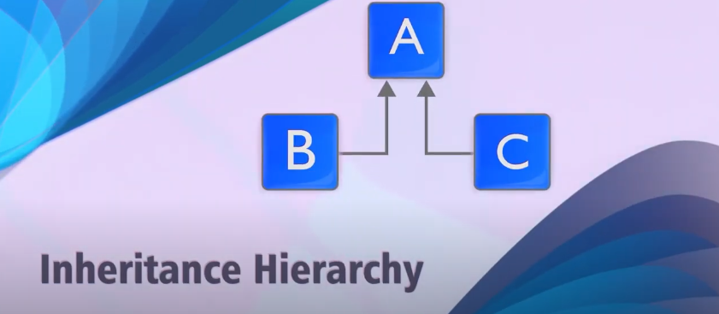
Relationship between Classes and Objects Inheritance

Slide 26
Relationship between Classes and Objects Inheritance
Inheritance hierarchy:
Shows the relationships among super-classes and sub-classes
The implicit possession by all subclasses of features defined in its super-classes.

Slide 27
Relationship between Classes and Objects Inheritance
The Isa rule

